Slide 1

Operating Systems
Lecture 6

Slide 2
Agenda for Today
Review of previous lecture
Process scheduling concepts
Process creation and termination
Process management in UNIX/Linux— system calls: fork, exec, wait, exit
Sample codes
Recap of the lecture

Slide 3
Review of Lecture 5
Browsing the UNIX/Linux directory structure
Useful UNIX/Linux commands
Process concept—attributes, states, types (CPU- and I/O-bound), PCB, OS queues, CPU scheduling, and context switch

Slide 4
Schedulers
Long term scheduler
Short term scheduler
Medium term scheduler

Slide 5

Queues in a Computer System

Slide 6
Long Term Scheduler
Long-term scheduler (or job scheduler) – selects processes from the job pool to be brought into the ready queue.
  Long-term scheduler is invoked very infrequently (seconds, minutes) ⇒ (may be slow).
  The long-term scheduler controls the degree of multiprogramming.
  More processes, smaller percentage of time each process is executed

Slide 7
Short Term Scheduler
Short-term scheduler (or CPU scheduler) – selects which process should be executed next and allocates it the CPU through the dispatcher.
  Short-term scheduler is invoked very frequently (milliseconds) ⇒ (must be fast).
  Invoked when following events occur
    CPU slice of the current process finishes
    Current process needs to wait for an event
    Clock interrupt
    I/O interrupt
    System call
    Signal

Slide 8
Medium Term Scheduler
Also known as swapper
Selects an in-memory process and swaps it out to the disk temporarily
Swapping decision is based on several factors
  Arrival of a higher priority process but no memory available
  Poor mix of jobs
  Memory request of a process cannot be met

Slide 9

Addition of Medium Term Scheduling

Slide 10
Context Switch
When CPU switches to another process, the system must save the state (context) of the ‘current’ (old) process and load the saved state for the new process.
Context-switch time is overhead; the system does no useful work while switching.
Time dependent on hardware support; typically in microseconds

Slide 11
Process Creation
Parent process create children processes, which, in turn create other processes, forming a tree of processes.
Resource sharing
  Parent and children share all resources.
  Children share a subset of parent’s resources.
  Parent and child share no resources.
Execution
  Parent and children execute concurrently.
  Parent waits until children terminate.

Slide 12
Process Creation …
Address space
  Child duplicate of parent.
  Child has a program loaded onto it.
UNIX examples
  fork system call creates a new process
  exec system call used after a fork to replace the process’ memory image with a new executable.

Slide 13

Processes Tree on a UNIX System

Slide 14
Process Termination
Process executes the last statement and requests the operating system to terminate it (exit).
  Output data from child to parent (via wait).
  Process resources are deallocated by the operating system, to be recycled later.

Slide 15
Process Termination …
Parent may terminate execution of children processes (abort).
  Child has exceeded allocated resources (main memory, execution time, etc.).
  Parent needs to create another child but has reached its maximum children limit
  Task performed by the child is no longer required.
  Parent exits.
    Operating system does not allow child to continue if its parent terminates.
    Cascaded termination

Slide 16
Process Management in UNIX/Linux
Important process-related UNIX/Linux system calls
  fork
  wait
  exec
  exit

Slide 17
fork()
When the fork system call is executed, a new process is created which consists of a copy of the address space of the parent.
This mechanism allows the parent process to communicate easily with the child process.
SYNOPSIS #include <sys/types.h> #include <unistd.h> pid_t fork(void);

Slide 18
fork() ...
The return code for fork is zero for the child process and the process identifier of child is returned to the parent process.
On success, both processes continue execution at the instruction after the fork call.
On failure, -1 is returned to the parent process and errno is set appropriately to indicate the reason of failure; no child is created

Slide 19
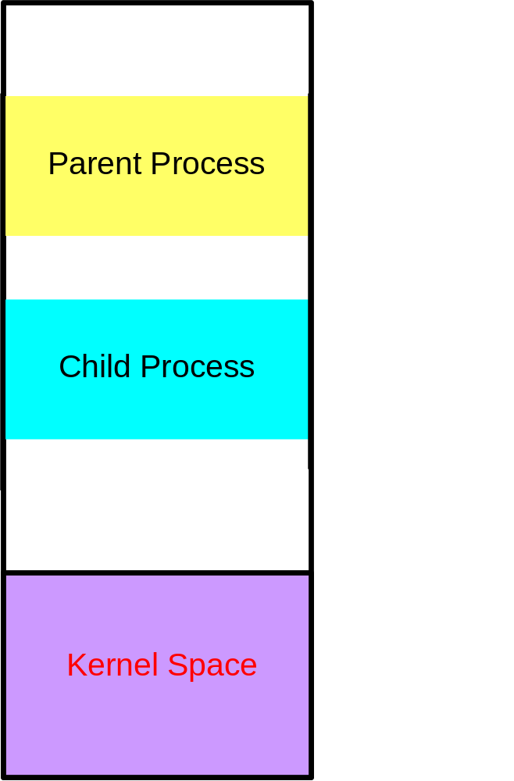
fork()—Sample Code
main()
{
int pid;
...
pid = fork();
if (pid == 0) {
/* Code for child */
...
}
else {
/* Code for parent */
...
}
...
}

Slide 20
fork()—Inherits from the Parent
The child process inherits the following attributes from the parent:
  Environment
  Open file descriptor table
  Signal handling settings
  Nice value
  Current working directory
  Root directory
  File mode creation mask (umask)
  Etc.

Slide 21
fork()—Child Differs from the Parent
The child process differs from the parent process:
  Different process ID (PID)
  Different parent process ID (PPID)
  Child has its own copy of parent’s file descriptors
  Etc.

Slide 22
fork()—Reasons for Failure
Maximum number of processes allowed to execute under one user has exceeded
Maximum number of processes allowed on the system has exceeded
Not enough swap space

Slide 23
Recap of Lecture
Review of previous lecture
Process scheduling concepts
Process creation and termination
Process management in UNIX/Linux— system calls: fork, wait, exit
Sample codes
Recap of the lecture

